Slide 1

Candidate: Valerio Longo 1655653
Advisor: Prof. Giuseppe Santucci
Co-Advisor: Dr. Simone Lenti
FACT-VIS: a visual tool for the analysis and security of firmware
Facoltà di Ingegneria dell’Informazione, Informatica e Statistica
Master’s degree in Engineering in Computer Science
A.Y. 2020-2021
Notes:
1

Slide 2
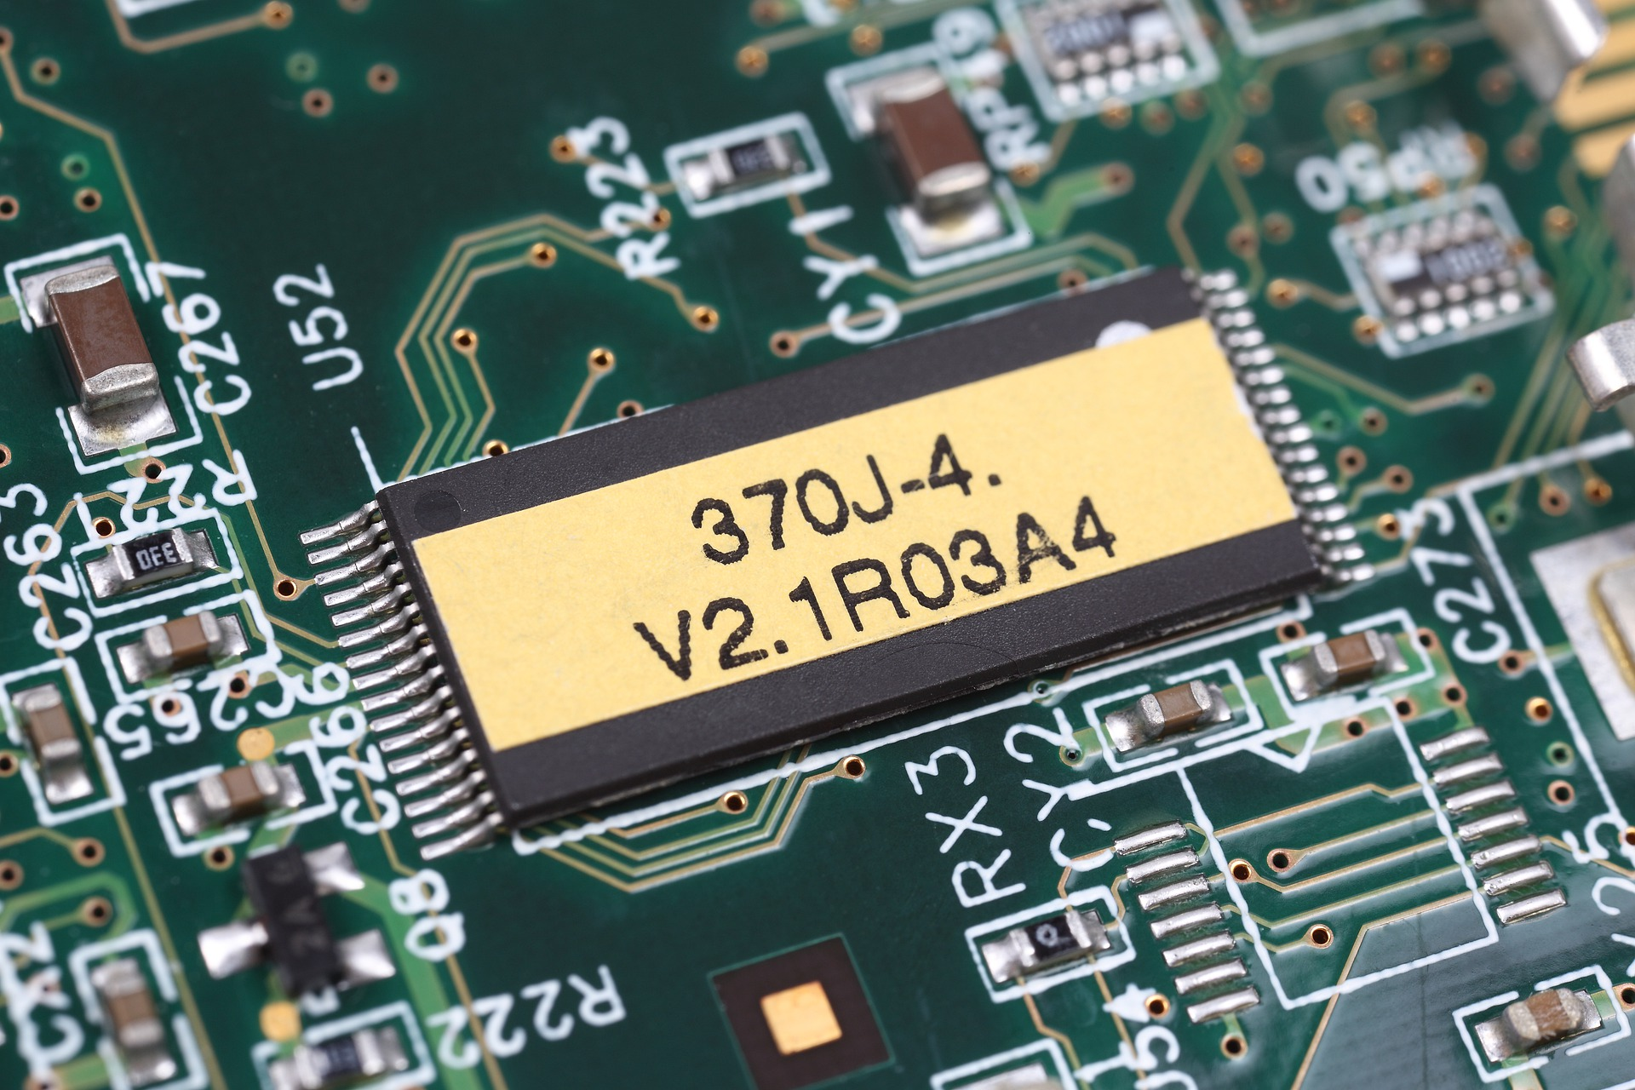
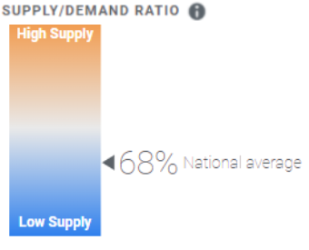

Introduction
Firmware is everywhere!
All electronic systems needs it
Domestic
Healthcare
Personal
Military
…
The spreading of IoT devices and COTS make easier the diffusion of firmware and with them their vulnerabilities.
This phenomena increased the need to perform firmware analysis, but this process is not completely automatable!
Lack of high technical skilled workforce which provide security and analyze the safety of firmware
cyberseek.org
FACT-VIS: a visual tool for the analysis and security of firmware
Longo Valerio
Notes:
software already available on the market, purchasable and reusable from any company
all electro devices which perform smart funct requires it
processo di analisi che ha una componente automatica ma con un analista che interagisce con esse

Slide 3

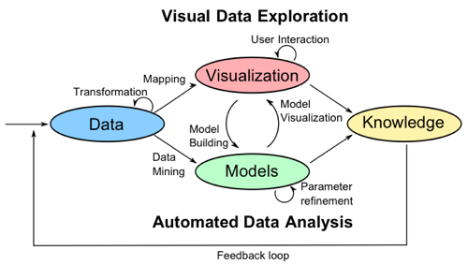
OWASP Methodology
A nine staged guide to tailor all domain’s interested with conducting firmware analysis.
Information gathering and reconnaissance
Obtaining firmware
Analyzing firmware
Extracting the filesystem
Analyzing filesystem contents
Emulating firmware
Dynamic analysis
Runtime analysis
Binary Exploitation
Visual Analytics connects the human cognitive capabilities with the computer computational power.
- Automated
- Needs support for users
Firmware security field requires the collaboration between automatic tools and users
FACT-VIS: a visual tool for the analysis and security of firmware
Longo Valerio
Notes:
Visual Analytics focuses on facilitate the user into perform analytical reasoning through interactive visual interfaces, using different visualization techniques, connecting the human cognitive capabilities with the computer computational power.

Slide 4








Our solution - FACT-Vis
FACT-VIS: a visual tool able to support the 3 stages of the firmware analysis process
FACT-Vis
Aimed to assist a large spectrum of users into support firmware analysis, providing:
General overviews of the firmware
Specific details of firmware and its components
Report to summarize the analysis process
FACT-VIS: a visual tool for the analysis and security of firmware
Longo Valerio
Notes:
With the goal of assist a large spectrum of users ( from cyber-security equipes to the hobbyists) into:
Study the flaws of a specific firmware
Provide different and customizable metrics (depending on the user’s skills)
Possibility to have a deeper interaction between the user and the firmware wrt other current tools (e.g. FACT)
Permit to have a better inspection of the data wrt other current tools (e.g. FACT)
Capability to get different projections of the same information, according to different points of view
siamo partiti da fact e l’abbiamo espano per farci piu cose
Build a software tool capable to:
Collect
Analyze
Discover
Evaluate firmware

Slide 5
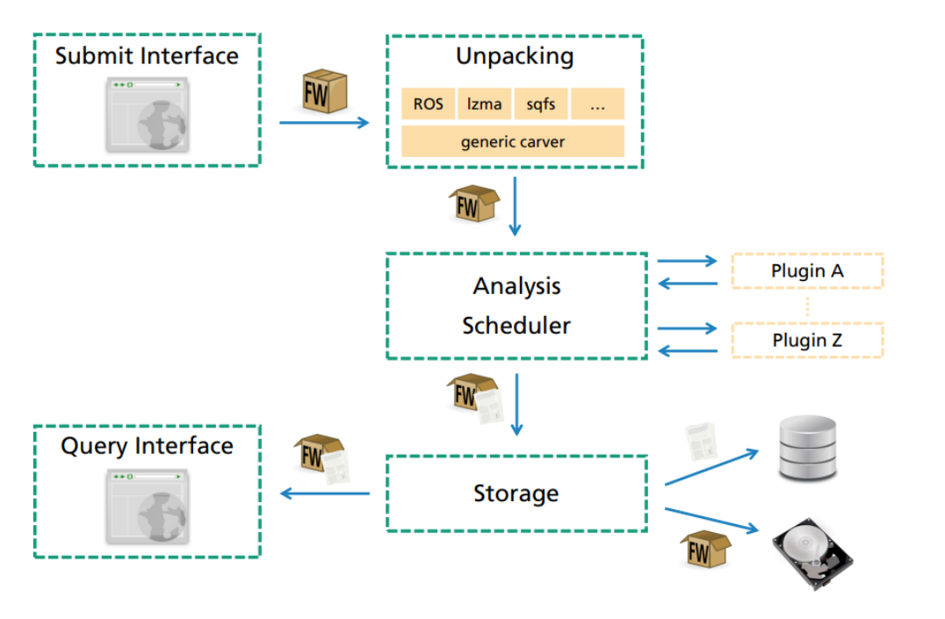
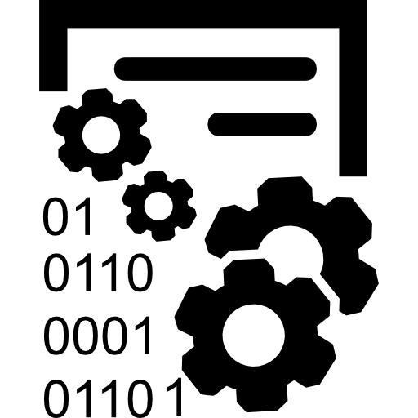



FACT - NVD
1 - Extraction
Unpacker
2 - Analysis
Meta info (file type, architecture, .. )
Security info (cracked credentials, mitigations, .. )
Modular and scalable architecture (Plug-in based)
3 - Report
GUI
pdf report
Collection of vulnerabilities and security flaws scored through the CVSS:
Standard and public
Prioritize risk providing both a general and specific metrics.
Well describes how much dangerous a flaw is
FACT-VIS: a visual tool for the analysis and security of firmware
Longo Valerio
Notes:
FACT converts the yara results ( started with a crypto rule match) and reports its output
unpacker (several plugins, binwalk included)
file_type (retrieve the MIME type of a file using python-magic)
cpu_architecture (detect metadata)
cve_lookup built using NIST static table
software_components extracted using Ghidra
crypto_material (detect SSH keys and SSL certificates exploiting YARA)
users_and_password cracked using John the Ripper
exploit mitigation of ELF binaries provided by checksec
FACT’s GUI
pdf report

Slide 6

Design process
The nested model ^{[1]}: four nested layers which describe the path starting from the domain problem until the intuition of the actual solution.
Domain Characterization
Data/Task
Abstraction
Design Conceptualization
Implementation
FACT-Vis
Requirement Collection
 | ID | Description
Overview | R1 | Capability to see the overview of the most critical file objects
 | R2 | Capability to see the overview of the firmware’s status
Firmware | R3 | Capability to analyze the firmware
 | R3.1 | Capability to see the overview of the firmware composition
 | R3.2 | Capability to maintain the focus only on certain aspects during the navigation of the firmware
File objects | R4 | Capability to analyze generic file objects
 | R4.1 | Capability to analyze packed file objects
 | R4.2 | Capability to analyze security flaws associated to files objects
Report | R5 | Capability to provide a concrete summary of the analysis done
User Profiling
[1] Interactive visual
data analysis. 1st ed.
FACT-VIS: a visual tool for the analysis and security of firmware
Longo Valerio
Notes:
The highlighting of the user needs (user-centered design);
• Compare the abstraction of a problem with similar ones applied in different contexts; •
Shorten the distances between the designer and the domain experts

Slide 7
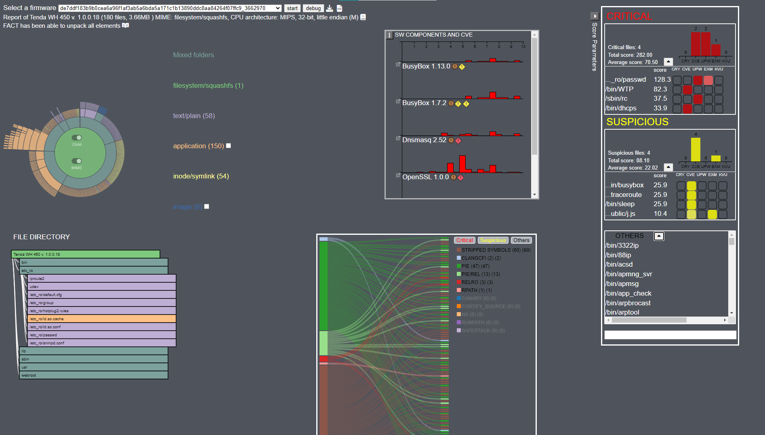
Unpacker log
Security aspects
Prioritization and detailed info
Navigation and firmware structure

Slide 8
Unpacker
The analysis process starts from the unpacking of the firmware.
Inform the user about the unpacking process and identifies which element has not been correctly unpacked
R4.1 | Capability to analyze packed file objects
NOTE: this process is prone to errors, it can produce false positives or files with some garbage attached at the end → need to alert the user
FACT-VIS: a visual tool for the analysis and security of firmware
Longo Valerio

Slide 9
Firmware Navigation
After the extraction, the user need to explore the firmware
Overview and navigation must coexists in this phase, so we need two synchronized and customizable visualization
according to the user needs
R3 | Capability to explore the firmware
R3.1 | Capability to see the overview of the firmware composition
R3.2 | Capability to maintain the focus only on certain aspects during the navigation of the firmware
FACT-VIS: a visual tool for the analysis and security of firmware
Longo Valerio

Slide 10
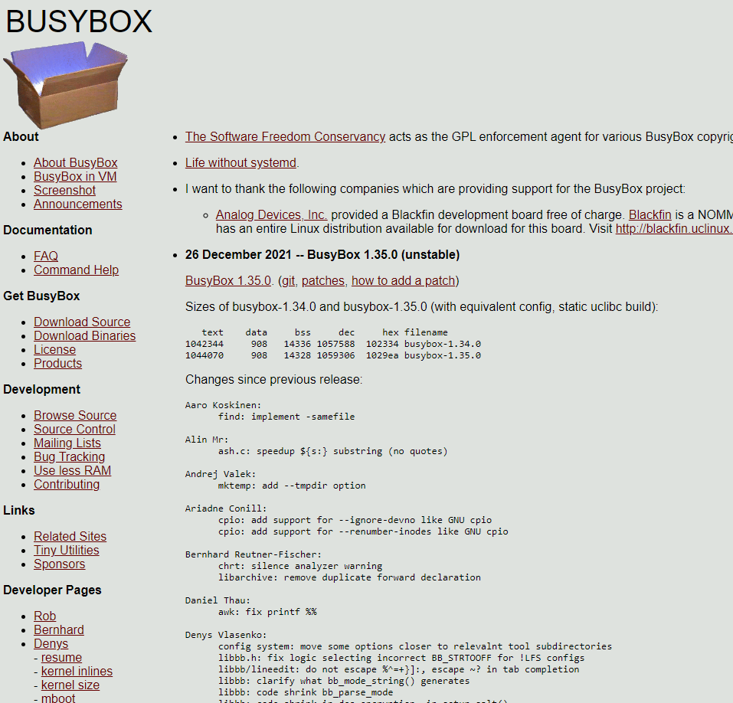
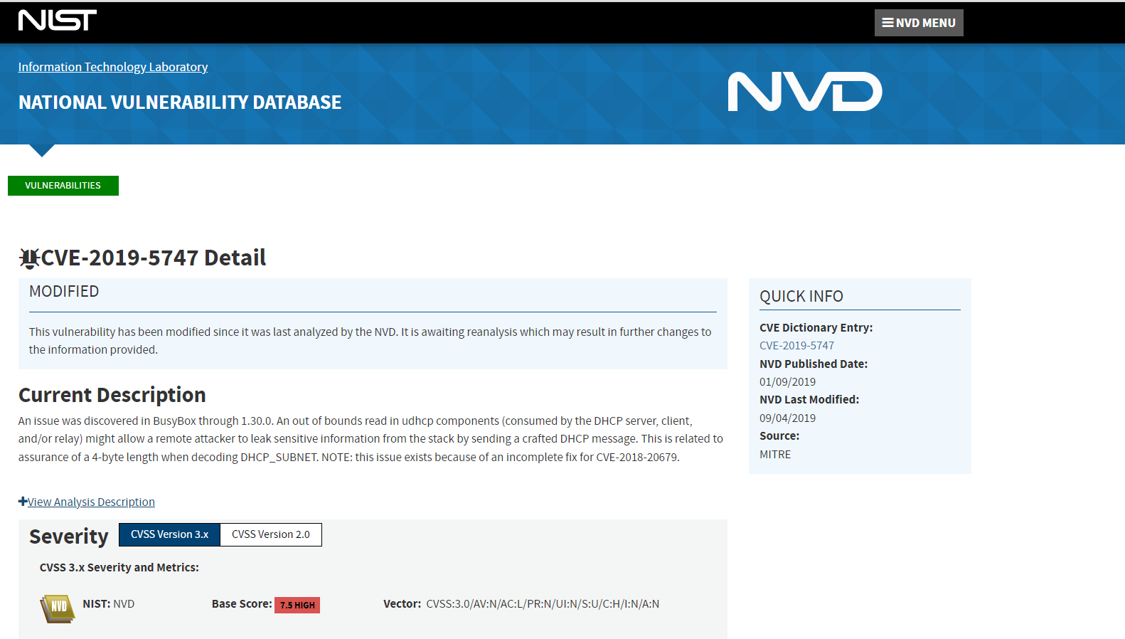
Software components and CVE
The user checks the sw component security aspects
Through cve external data sources and integration, each component shows its cve distribution according to different parameters
R2 | Capability to see the overview of the firmware’s status
R4.2 | Capability to analyze security flaws associated to files objects
FACT-VIS: a visual tool for the analysis and security of firmware
Longo Valerio
Notes:
NOTA CON I FILE ROSSI E GIALLI

Slide 11
Exploit mitigation
The user checks the file objects security aspects
Bipartite Graph capable to inspect the security problems of a single file object and/or visualize the spread of security best practices
Mitigations found in executable files encoded following the color set in the legenda.
File objects in function of mitigations and vice versa
R2 | Capability to see the overview of the firmware’s status
R4.2 | Capability to analyze security flaws associated to files objects
FACT-VIS: a visual tool for the analysis and security of firmware
Longo Valerio
Notes:
File objects in funtion of mitigations and viceversa

Slide 12
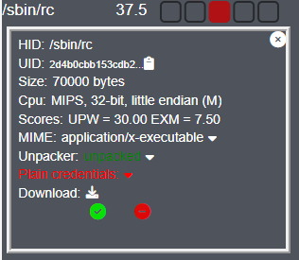
Rank Danger
Main goal is to prioritize the files based on their security aspects
FACT-Vis automatically categorize a file as Critical , Suspicious or Other
R1 | Capability to see the overview of the most critical file objects
Each flaw is counted and weighted based on the user needs
R2 | Capability to see the overview of the firmware’s status
Bar chart and score information
R4 | Capability to analyze generic file objects
Technical data sheet and personal file information
FACT-VIS: a visual tool for the analysis and security of firmware
Longo Valerio

Slide 13
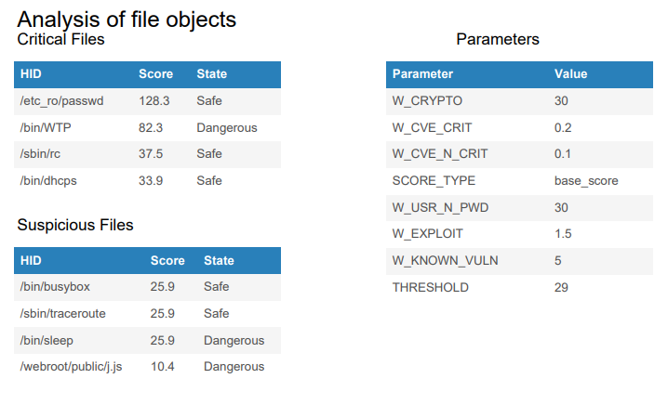
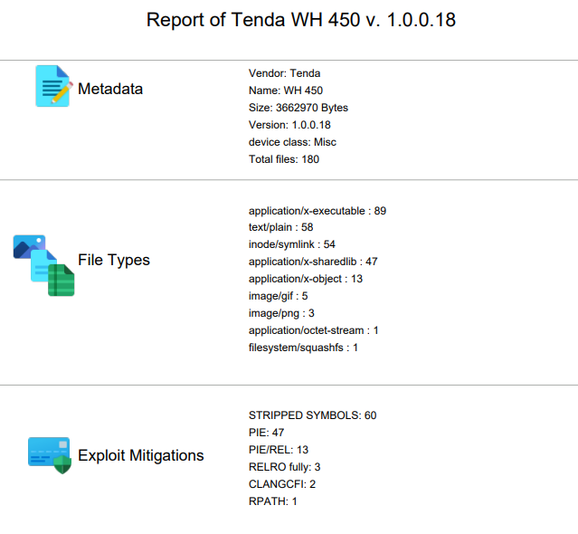
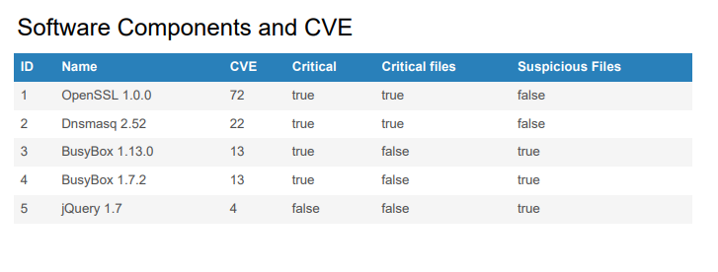
Report
R5 | Capability to provide a concrete summary of the analysis done
FACT-VIS: a visual tool for the analysis and security of firmware
Longo Valerio

Slide 14
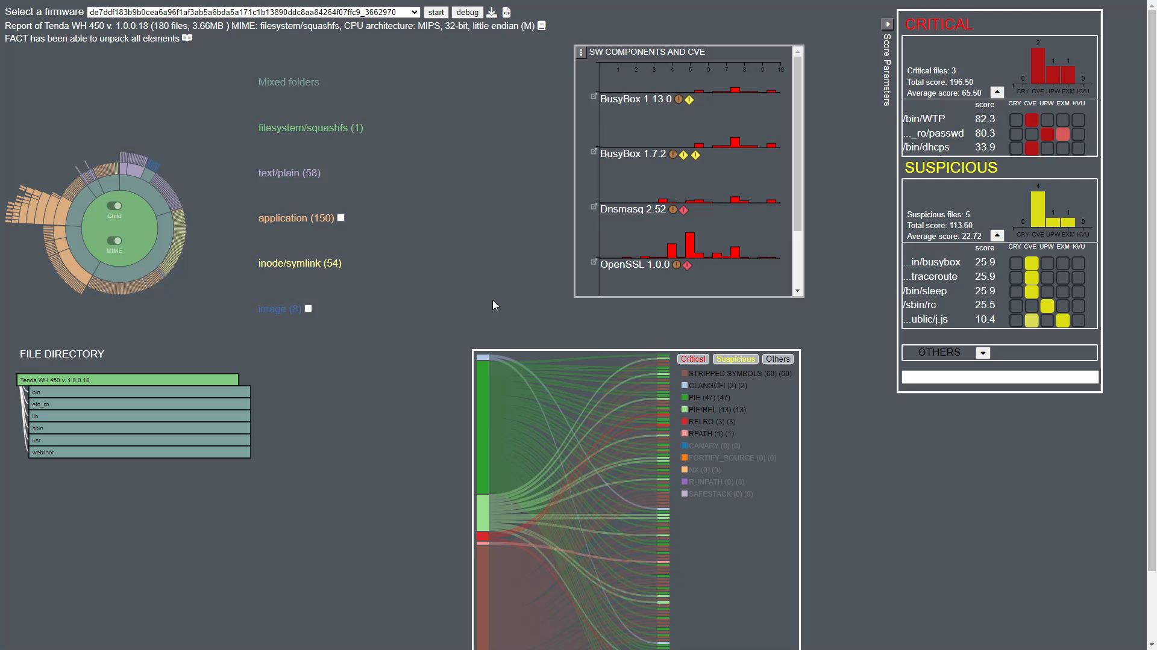
FACT-VIS: a visual tool for the analysis and security of firmware
Longo Valerio
Notes:
NOTA CON I FILE ROSSI E GIALLI

Slide 15
Conclusion
FACT-Vis is designed to support wide range of users (from cyber-security equipes to hobbyists) in performing firmware analysis, enhancing FACT’s power.
FACT-Vis is a transverse project, which connect two different fields of study: the firmware analysis and the visual analytics.
Future works:
Investigate and master the OWASP stages considered
Integrate FACT-Vis with other stages
Consolidate FACT-Vis with the methodology
Improve the system through user’s feedback
FACT-VIS: a visual tool for the analysis and security of firmware
Longo Valerio
Notes:
NOTA CON I FILE ROSSI E GIALLI

Slide 16
Thanks for your attention
FACT-VIS: a visual tool for the analysis and security of firmware
Longo Valerio
Notes:
NOTA CON I FILE ROSSI E GIALLI

